Slide 1
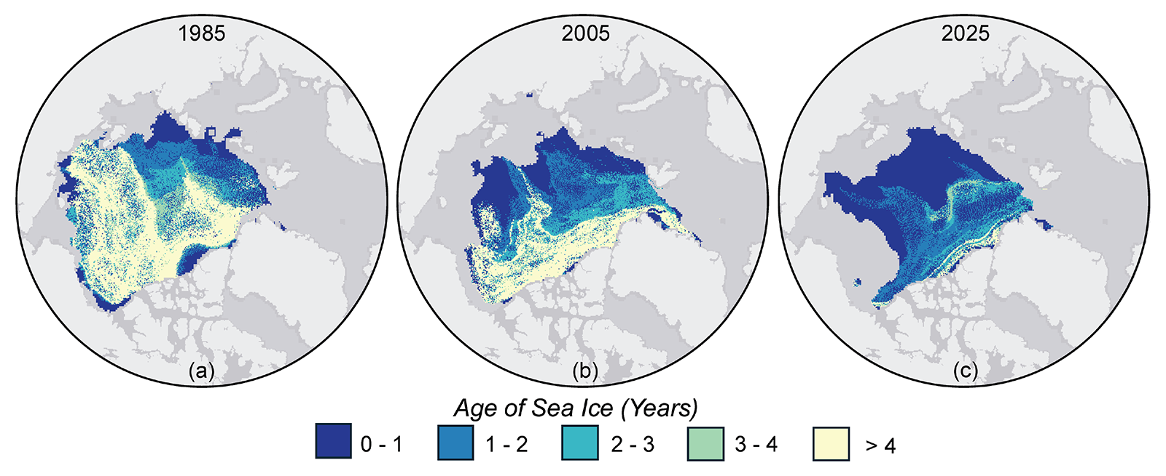
The last 19 years contain the 19 lowest observed sea-ice extents (NOAA)
Notes:
On the satellite record

Slide 2
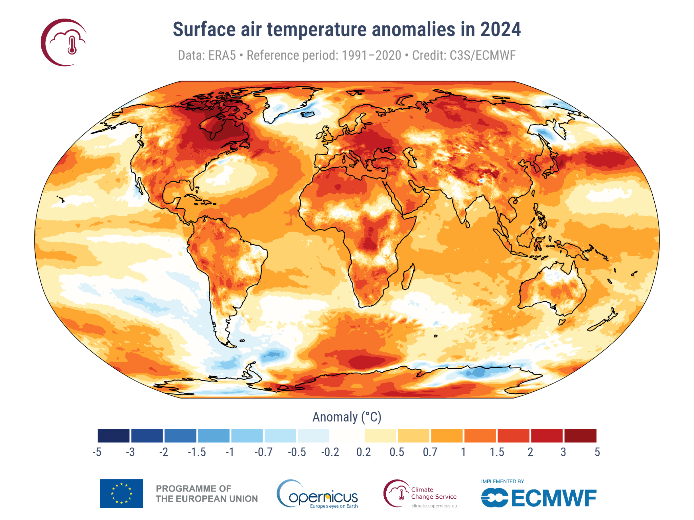
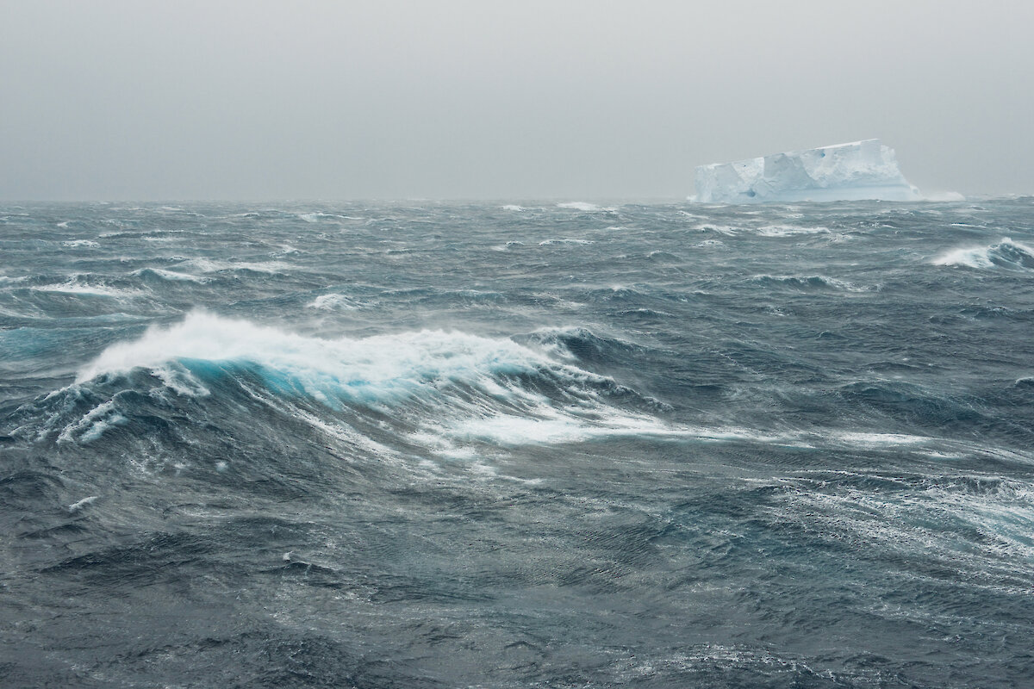
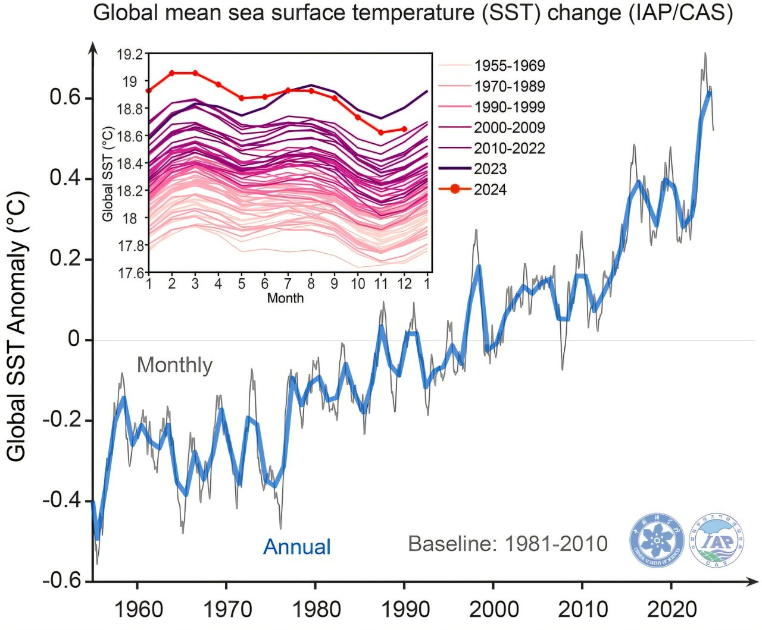
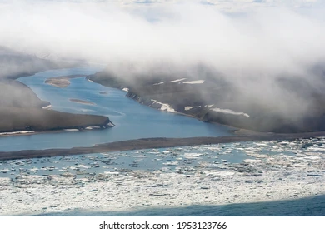
Primary mechanisms of sea ice melt
Air temp.
Wave action
River heat flux
Ocean temp.
Rising air temperature
Rising ocean temperature
Increased wave action
Increased riverine heat flux
Notes:
On the satellite record

Slide 3
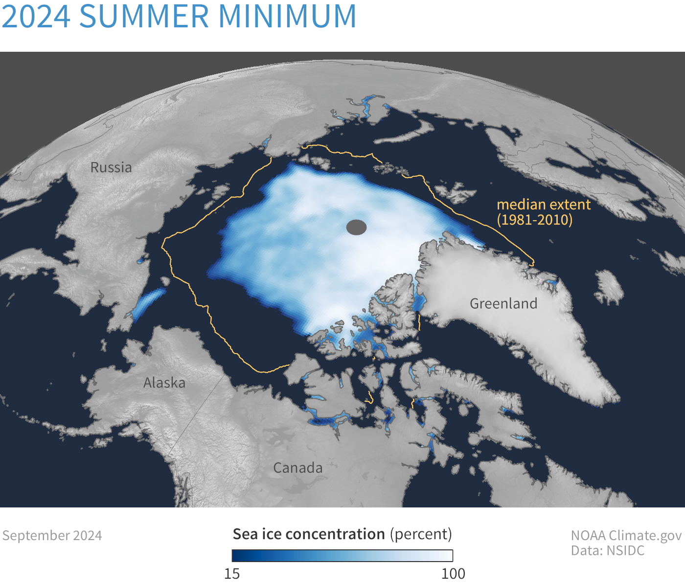
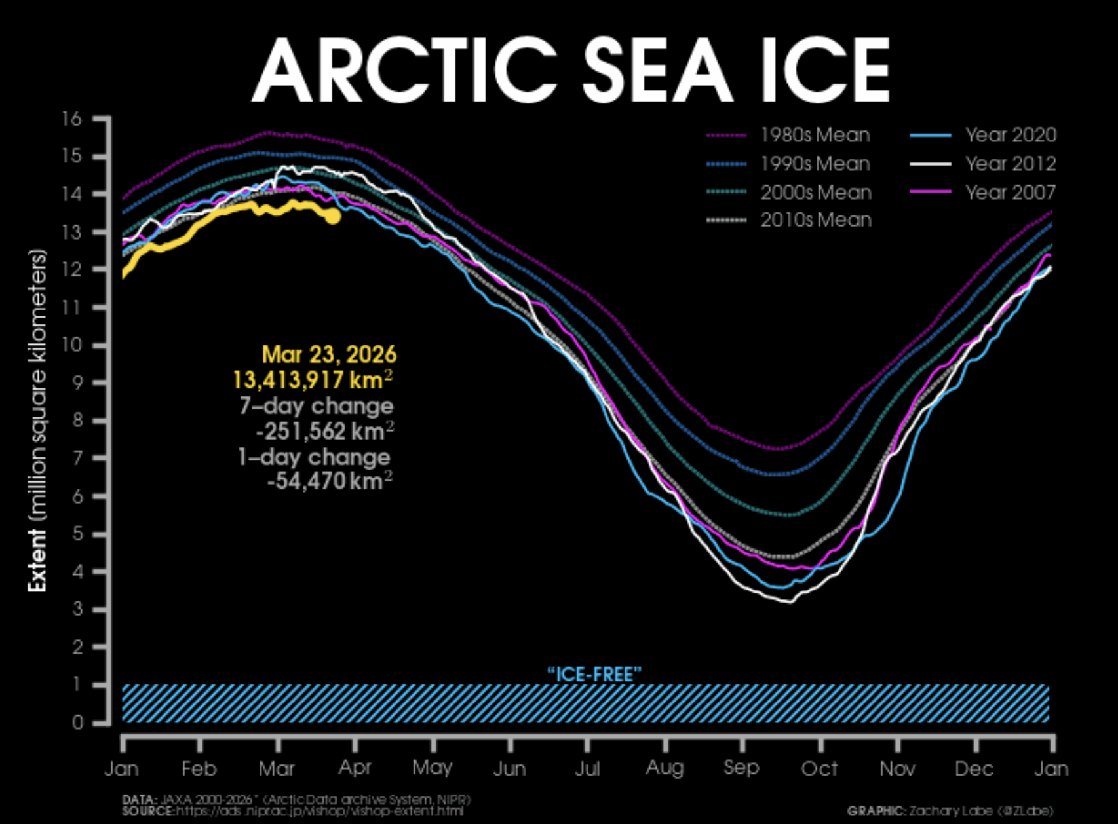
The decadal trend is a reduction in Arctic sea ice extent
https://www.climate.gov/maps-data/data-snapshots/data-source/arctic-sea-ice-extent-minimum
https://zacklabe.com/arctic-sea-ice-extentconcentration/

Slide 4
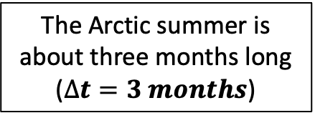





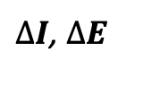
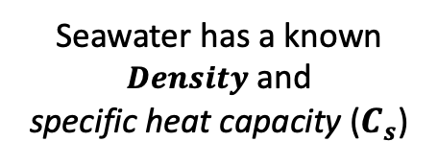
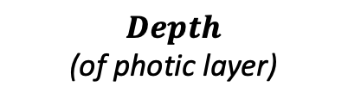
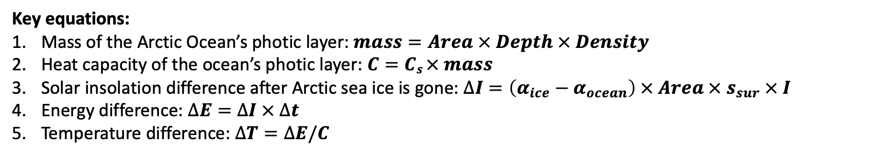
Ice-Free Arctic schematic: What will happen if we remove all of the existing ice?
clouds

Slide 5
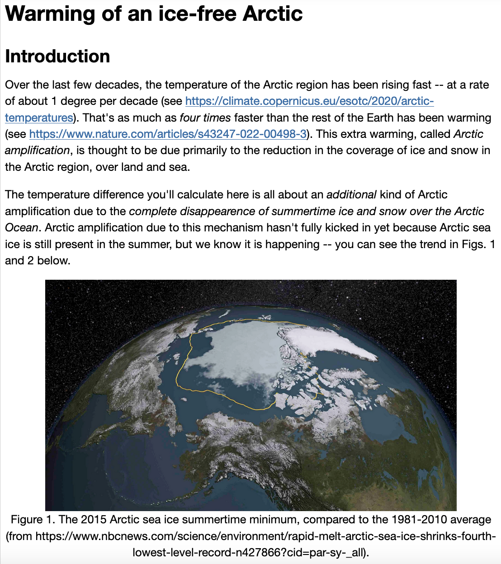
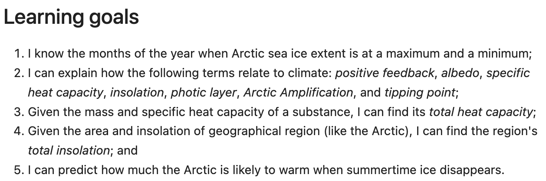
OK, let’s get started

